Slide 1
Biodiversity Research
10-22-16

Slide 2
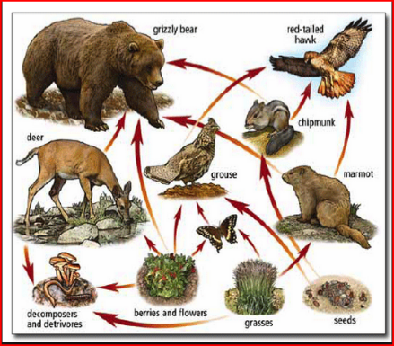
Biodiversity
Video

Slide 3
I Can…
1. List 3 kinds of pollution
2. Describe how habitat destruction affects biodiversity

Slide 4
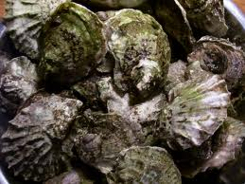
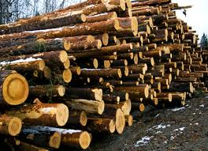
Biodiversity
Please complete the following on your Biodiversity Research…
1) Explain the importance of conservation (pg.162)
2) Describe the three R’s (pgs 163-165)
3) Explain how biodiversity can be maintained (pg.166)
4) Describe five environment strategies (pg.167)
5) Applying: What kinds of things can you do to help maintain biodiversity
I can list 3 kinds of pollution.
I can describe how habitat destruction affects biodiversity.

Slide 5
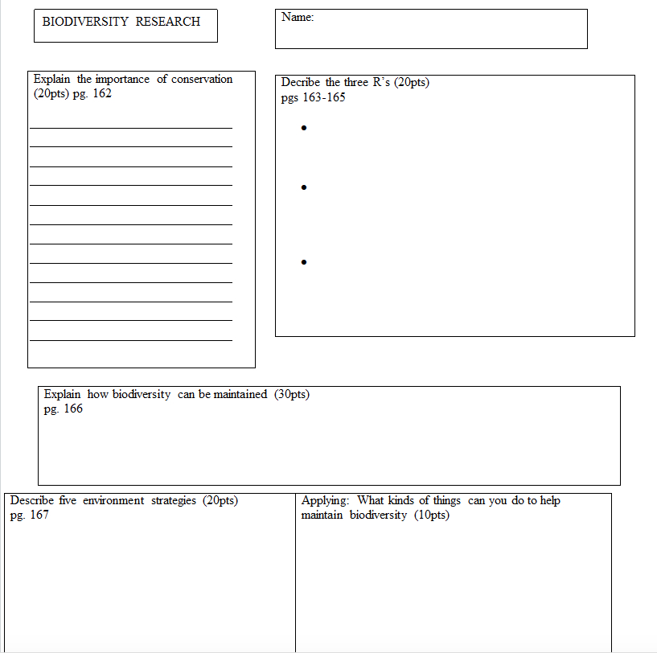
I can list 3 kinds of pollution.
I can describe how habitat destruction affects biodiversity.

